Slide 1
LEAD SCORE CASE STUDY
SUBMITTED BY
SHARADHI KULKARNI

Slide 2
PROBLEM STATEMENT
X education is an organization which provides online courses for industry professional. The company marks its courses on several popular websites like google.
X education wants to select most promising leads that can be converted to paying customers.
Although the company generates a lot of leads only a few are converted into paying customers, wherein the company wants a higher lead conversion. Leads come through numerous modes like email, advertisements on websites, google searches etc.
The company has had 30% conversion rate through the whole process of turning leads into customers by approaching those leads which are to be found having interest in taking the course. The implementation process of lead generating attributes are not efficient in helping conversions.

Slide 3
BUSINESS GOAL
The company requires a model to be built for selecting most promising leads.
Lead score to be given to each leads such that it indicates how promising the lead could be. The higher the lead score the more promising the lead to get converted, the lower it is the lesser the chances of conversion.
The model to be built in lead conversion rate around 80% or more.

Slide 4
STRATEGY
Import data
Clean and prepare the acquired data for further analysis
Exploratory data analysis for figuring out most helpful attributes for conversion
Scaling features
Prepare the data for model building
Build a logistic regression model
Assign a lead score for each leads
Test the model on train set
Evaluate model by different measures and metrics
Test the model on test set
Measure the accuracy of the model and other metrics for evaluation

Slide 5
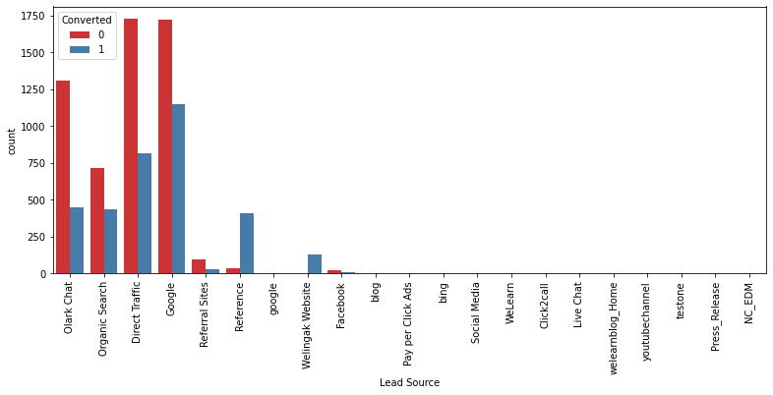
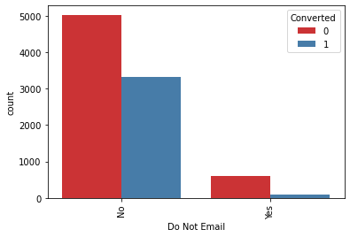
EXPLORATORY DATA ANALYSIS
LEAD SOURCE VS CONVERTED
DO NOT EMAIL VS CONVERTED

Slide 6
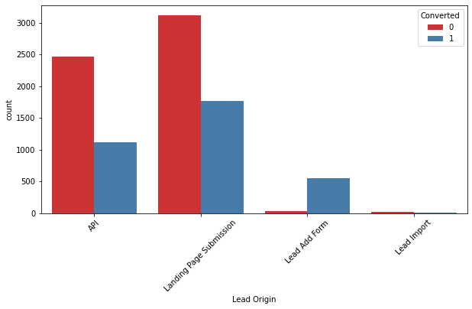
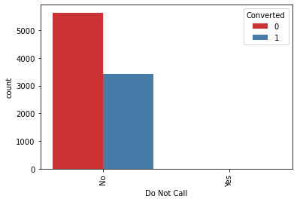
EXPLORATORY DATA ANALYSIS
LEAD ORIGIN VS CONVERTED
DO NOT CALL VS CONVERTED

Slide 7
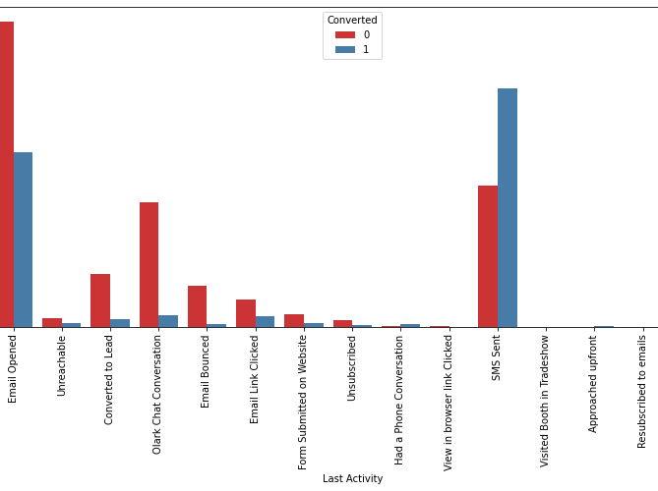
EXPLORATORY DATA ANALYSIS
LAST ACTIVITY VS CONVERTED

Slide 8
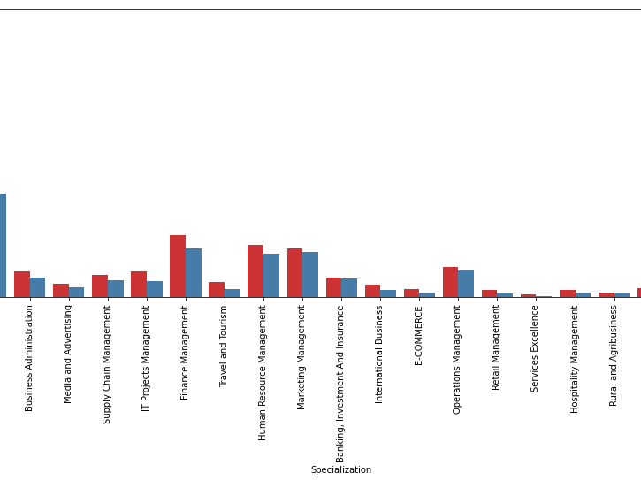
EXPLORATORY DATA ANALYSIS
SPECIALIZATION VS CONVERTED

Slide 9
MODEL BUILDING
Splitting into train and test set
Scale variables in train set
Build the first model
Use RFE to eliminate less relevant variables
Build the next model
Eliminate variables based on high p-values
Check VIF value for all the existing columns
Predict using train test
Evaluate accuracy and other metric
Predict using test set
Precision and recall analysis on test predictions

Slide 10
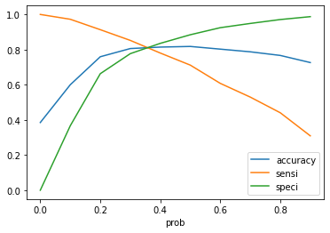
MODEL EVALUATION (TRAIN)
ACCURACY SENSITIVITY AND SPECIFICITY
81.1% ACCURACY
82.74% SENSITIVITY
80.07% SPECIFICITY

Slide 11
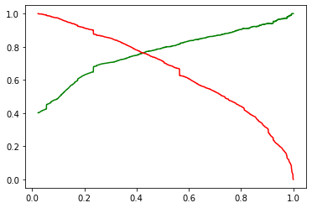
MODEL EVALUATION (TRAIN)
PRECISION AND RECALL
79.42% PRECISION
71.17% RECALL

Slide 12
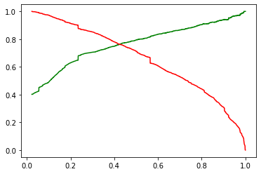
MODEL EVALUATION (TEST)
PRECISION AND RECALL
79.42%
71.14%
ACCURACY SENSITIVITY AND SPECIFICITY
Accuracy : 80.4 %
Sensitivity : 80.4 %
Specificity : 80.5 %

Slide 13
CONCLUSION
While we have checked both sensitivity-specificity as well as precision and recall metrics, we have considered the optimal cutoff based on sensitivity and specificity for calculating the final prediction.
Accuracy, sensitivity and specificity values of test set are around 81.1%, 82.74% and 80.07% which are approximately closer to the respective values calculated using trained set.
Also the lead score calculated shows the conversion rate on the final predicted model is around 80% (in train set) and 79% in test set.
The top 3 variables that contribute for lead getting converted in the model are
Total time spent on website
Lead add form from lead origin
Had a phone conversation from last notable activity
Hence overall this model seems to be good.

